Slide 1
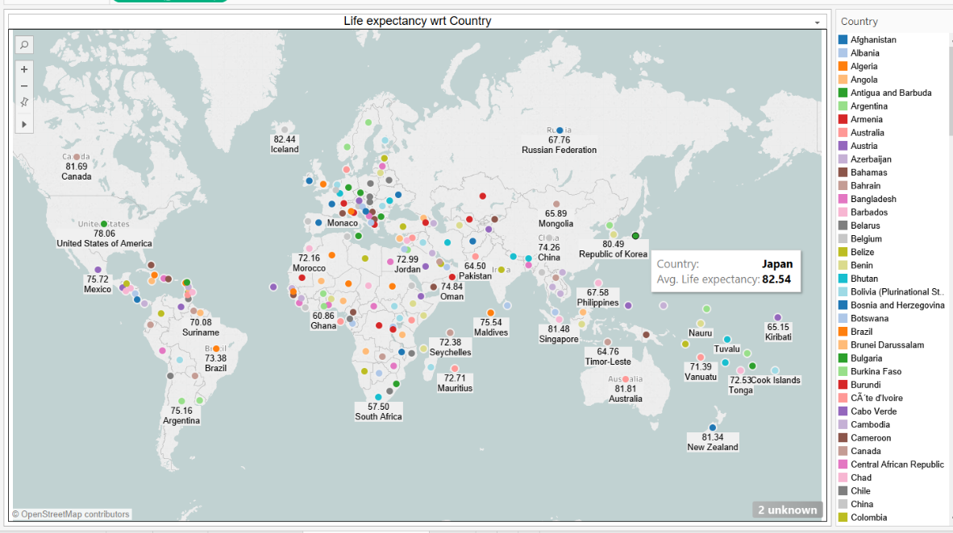
Regression Summary
Life Expectancy (WHO)

Slide 2
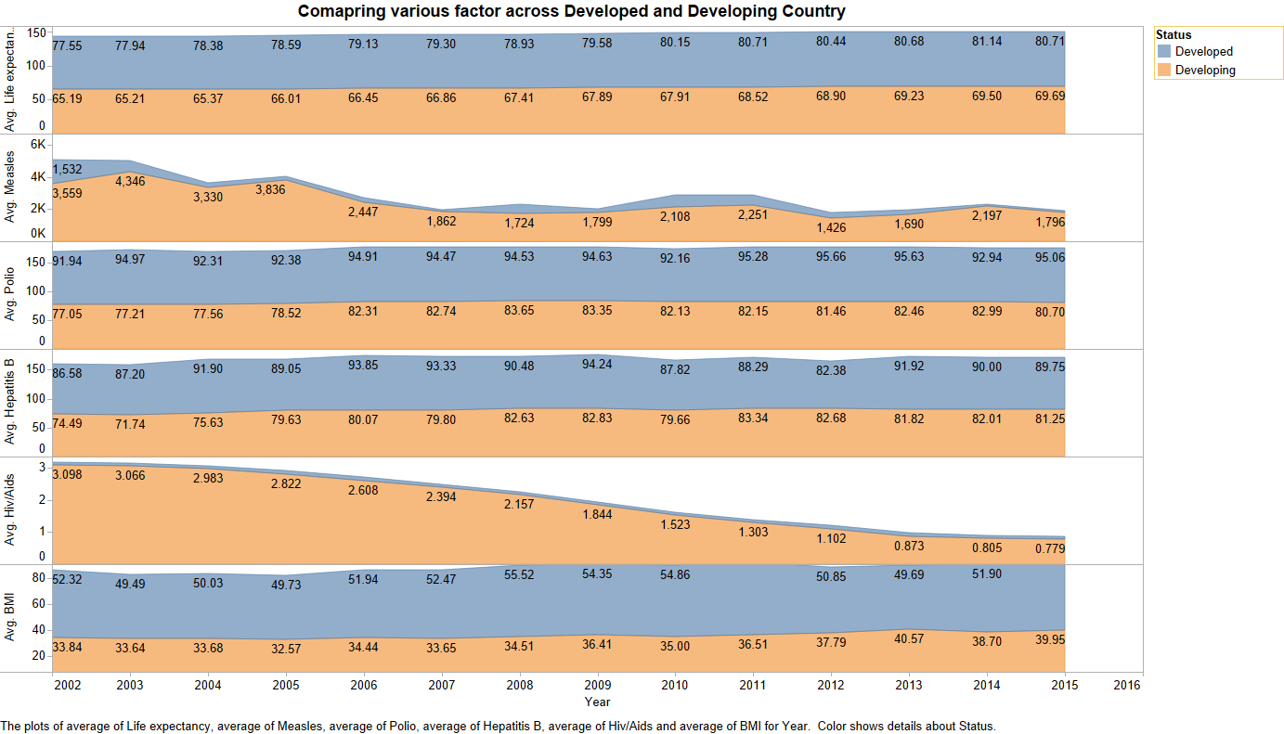

Slide 3
Predicting
Project Objective : We have picked up this dataset to observe the impact of development in health sector on life expectancy of an individual across 193 countries
Trying to predicts life expectancy of an individual by observing the Immunization related factors, Mortality factors, Economical factors and Social factors which impacts life expectancy.
Total executed model | 24
Best model: | Gradient Boosting Regression
R2score: | 0.9423
Shape of dataset | (2938,22)
Shape of dataset after Imputation | (2938, 18)
Shape of the dataset after PCA : | (2938, 11)

Slide 4
Dataset feature: Shape of dataset :- (2938,22)
Data
Country
Year
Status
(Developed or Developing status)
Adult Mortality
(Adult Mortality Rates of both sexes (probability of dying between 15 and 60 years per 1000 population)
infant deaths
(Number of Infant Deaths per 1000 population)
BMI
Measles
(Measles - number of reported cases per 1000 population)
Hepatitis B
(Hepatitis B (HepB) immunization coverage among 1-year-olds (%))
percentage expenditure (percentage expenditure: Expenditure on health as a percentage of Gross Domestic Product per capita(%)
Alcohol
(Alcohol, recorded per capita (15+) consumption (in litres of pure alcohol))
under-five deaths (Number of under-five deaths per 1000 population)
Polio
(Polio (Pol3) immunization coverage among 1-year-olds (%))
Total expenditure
Diphtheria
(Diphtheria tetanus toxoid and pertussis (DTP3) immunization coverage among 1-year-olds (%))
HIV/AIDS
(Deaths per 1 000 live births HIV/AIDS (0-4 years)
Income composition of resources (Human Development Index in terms of income composition of resources (index ranging from 0 to 1)
thinness 5-9 years
(Prevalence of thinness among children for Age 5 to 9(%))
thinness 1-19 years
(Prevalence of thinness among children for Age 5 to 9(%))
Population
GDP
Schooling
(Number of years of Schooling(years)
Life expectancy
[Target Variable]

Slide 5
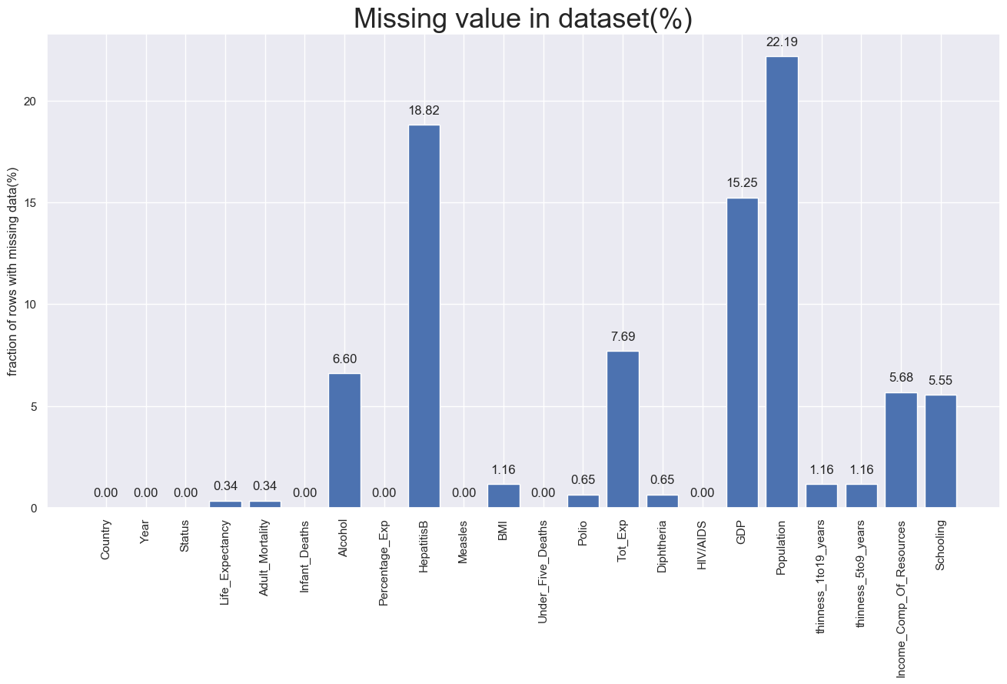
Data
The dataset related to life expectancy, health factors for 193 countries has been collected from the same WHO data repository website and its corresponding economic data was collected from United Nation website.
There has been tremendous development in health sector which result in improvement in mortality rate which is point of further analysis in this dataset.

Slide 6
Features
1)Shape of dataset :- (2938,22)
2) Preprocessing steps :-
Handling Missing value: Replace NaN in each column with the respective column Median
Data transformation:
a) Renamed some column names as they contain trailing spaces e.g. Who_df.rename(columns={" BMI ":"BMI", },inplace=True)
b) Mapped 'Developing':0,'Developed':1 in Column 'Status’
c) Dropped column ‘country’ as it has 193 unique value
d) Dropped column 'Under_Five_Deaths','thinness_5to9_years','Percentage_Exp’
Scaling: MinMax Scaling
3) Data imputation:
Shape of dataset :- (2938,18)
X_train .shape | (2056,17)
X_test.shape | (882,17)
y_train.shape | (2056)
y_test.shape | (882)

Slide 7
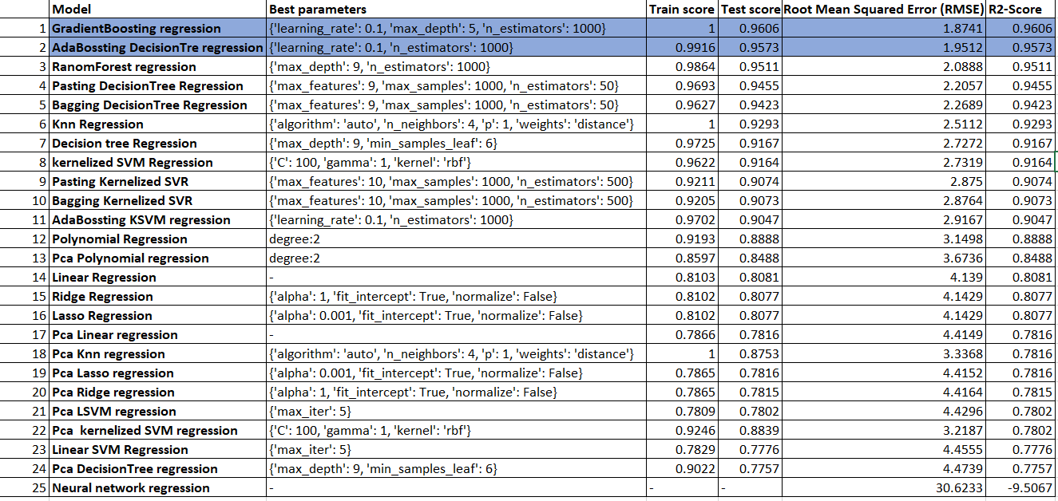
Models Result

Slide 8
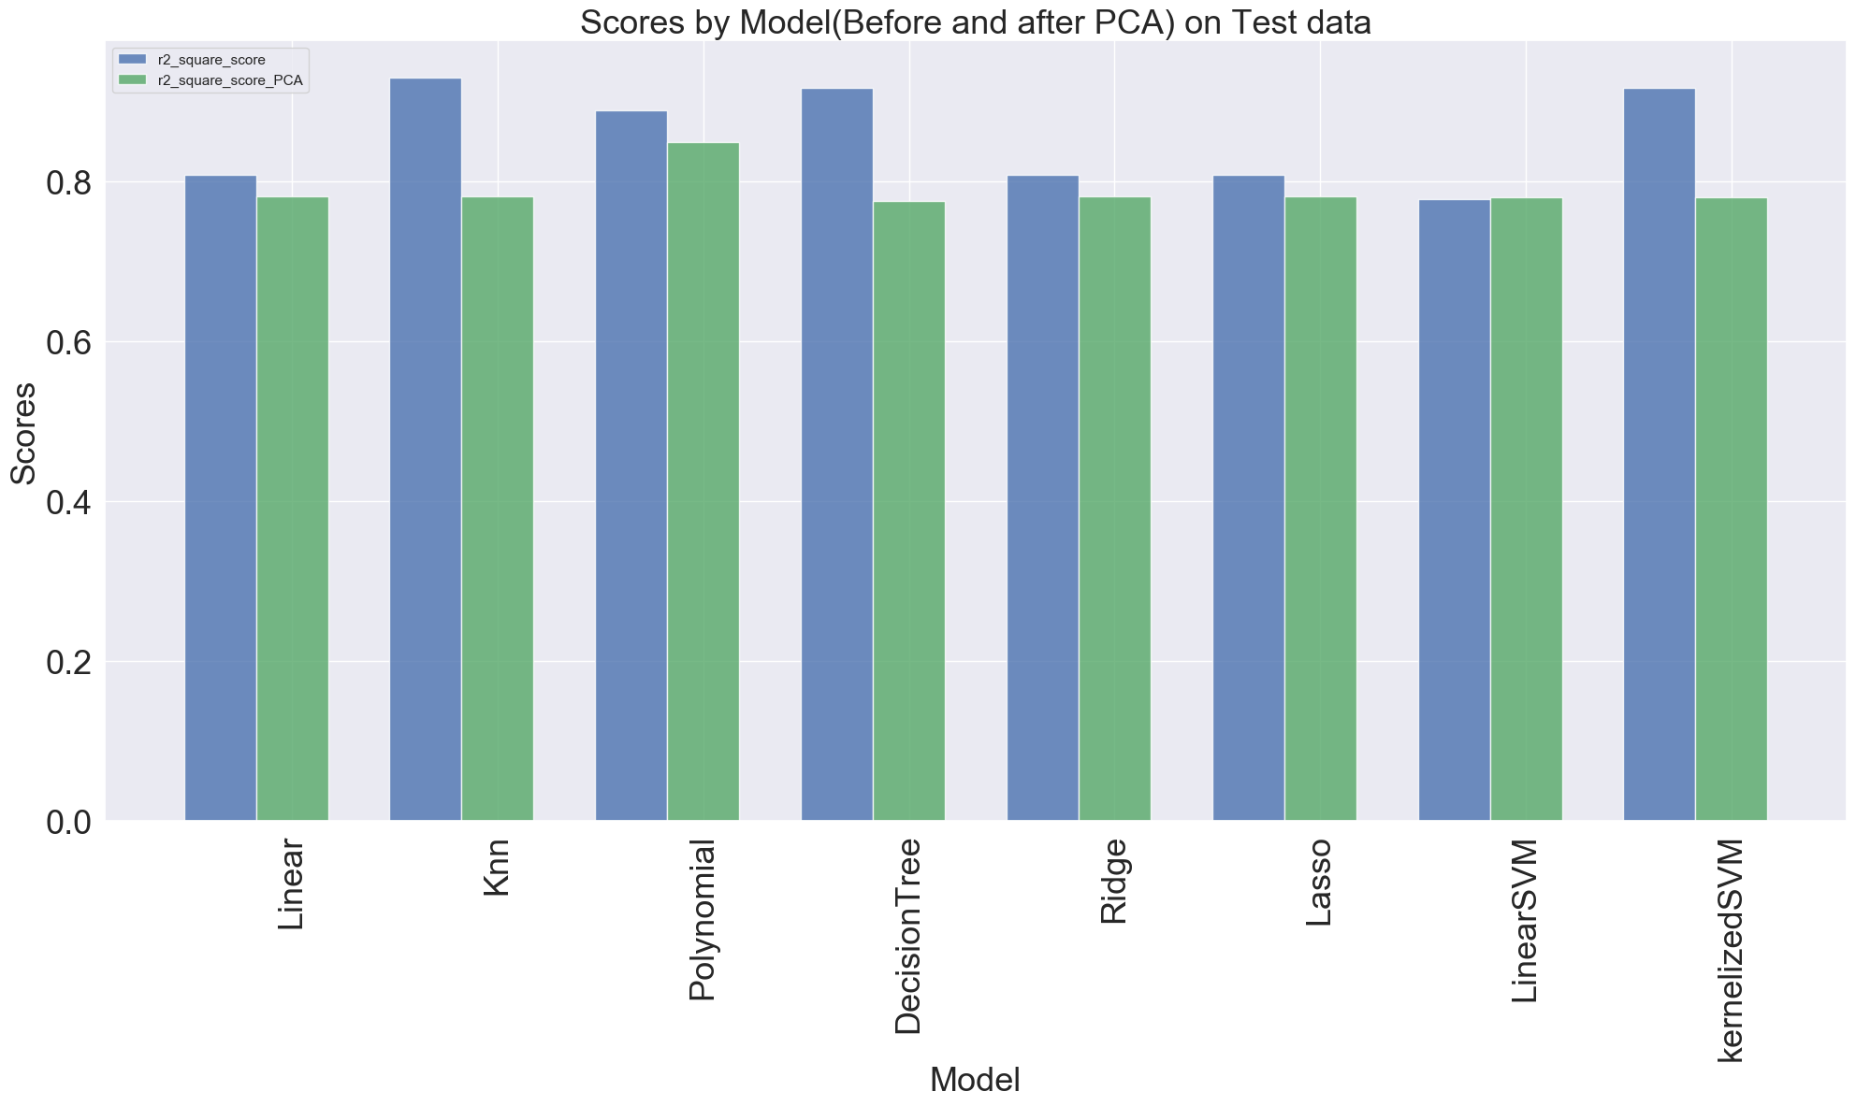

Slide 9
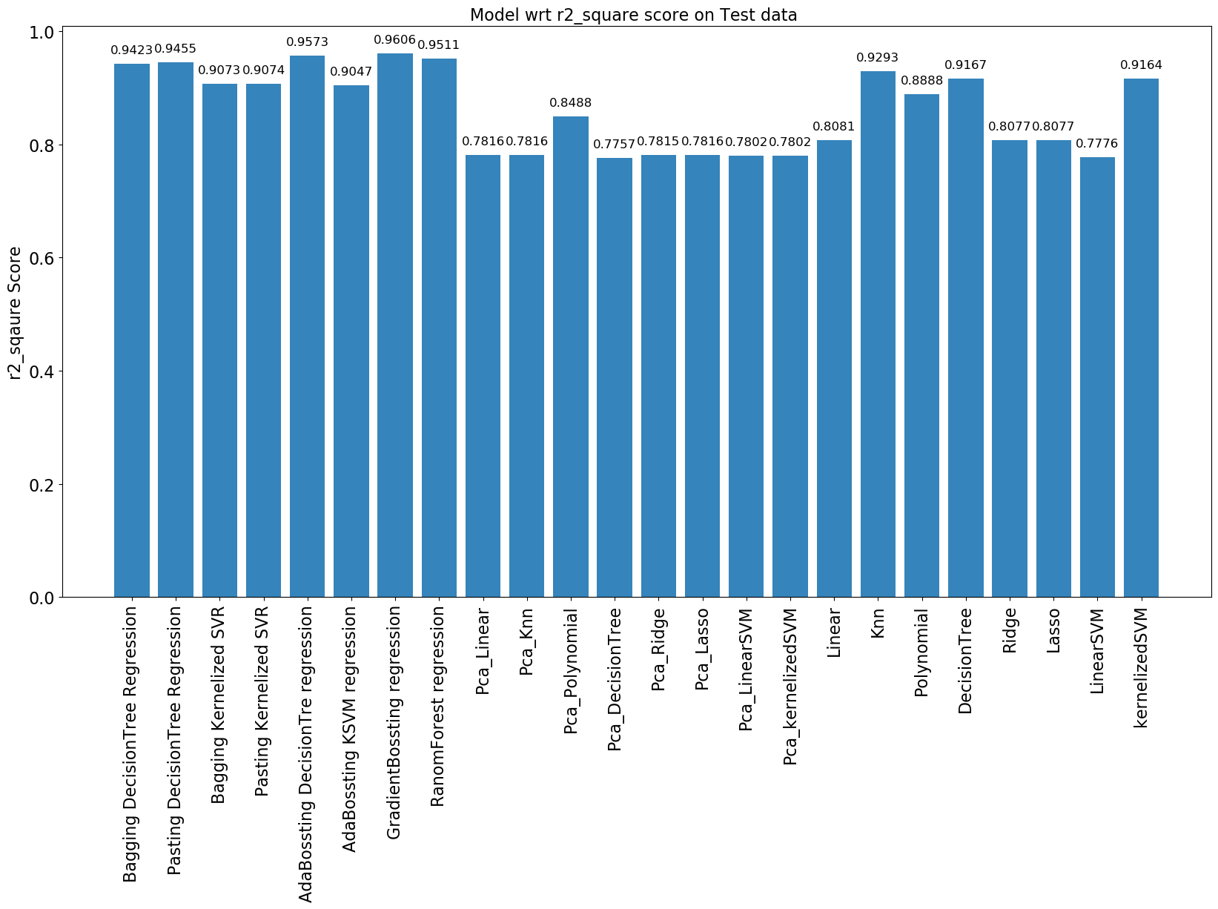

Slide 10
References:
The data was collected from WHO and United Nations website with the help of Deeksha Russell and Duan Wang.
Data Source Link:
https://www.kaggle.com/kumarajarshi/life-expectancy-who
Future Study :
It would be interesting to analyze the activity level(lifestyle/exercise level) of population across country.
Look at class within a particular country and see if these same factors are same in determining life expectancy for an individual. Upper, Middle, and Lower Class ratios could be a very interesting feature to add on to the this study.
Increase the dataset size with continuing UN and Global Data data. Mental Health and Life Expectancy Correlation also seems essential to look further this study!

Slide 11
Discussion
Data Understanding: Life Expectancy has really improved as a result of improvement in health sector by Vaccination
Interesting facts: 1)Average Life Expectancy ranges are Developed(80-77), Developing (69-65)
2) Japan is the country with high Life expectancy
Expected PCA will improve the result but looks like because of some information loss didn’t get result as expected.
As in our first project k-nearest neighbors and KSVM Regressor performed well so expected their result will boost but Gradient Boosting regression outperformed all models

